Slide 1
Arrays
Chapter 7

Slide 2
Objectives
Nature and purpose of an array
Using arrays in Java programs
Methods with array parameter
Methods that return an array
Array as an instance variable
Use an array not filled completely

Slide 3
Objectives
Order (sort) the elements of an array
Search an array for a particular item
Define, use multidimensional array
Text fields, text areas in applets
Drawing arbitrary polygons in applets

Slide 4
Array Basics: Outline
Creating and Accessing Arrays
Array Details
The Instance Variable length
More About Array Indices
Analyzing Arrays

Slide 5

Creating and Accessing Arrays
An array is a special kind of object
Think of as collection of variables of same type
Creating an array with 7 variables of type double
To access an element use
  The name of the array
  An index number enclosed in braces
Array indices begin at zero

Slide 6
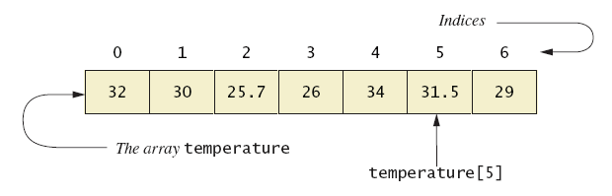
Creating and Accessing Arrays
Figure 7.1 A common way to visualize an array
Note sample program, listing 7.1
class ArrayOfTemperatures

Slide 7
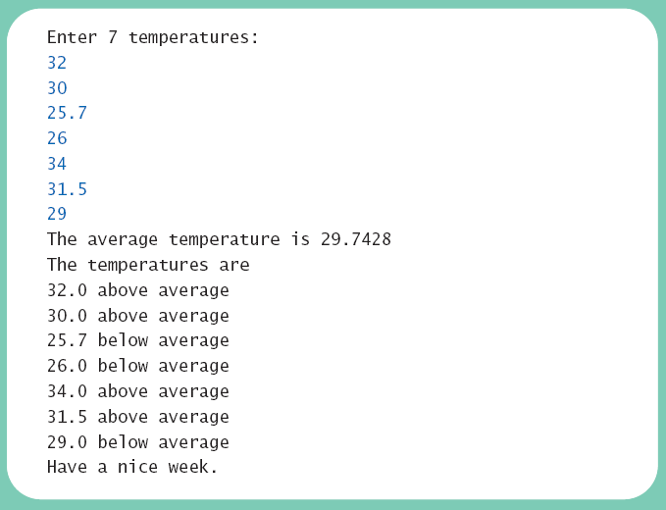
Creating and Accessing Arrays
Sample
screen output

Slide 8

Array Details
Syntax for declaring an array with new
The number of elements in an array is its length
The type of the array elements is the array's base type

Slide 9
Square Brackets with Arrays
With a data type when declaring an array
int [ ] pressure;
To enclose an integer expression to declare the length of the array
pressure = new int [100];
To name an indexed value of the array
pressure[3] = keyboard.nextInt();

Slide 10
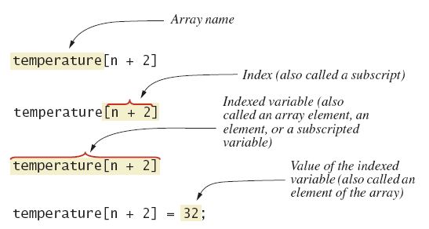
Array Details
Figure 7.2 Array terminology

Slide 11
The Instance Variable length
As an object an array has only one public instance variable
  Variable length
  Contains number of elements in the array
  It is final, value cannot be changed
Note revised code, listing 7.2
class ArrayOfTemperatures2

Slide 12
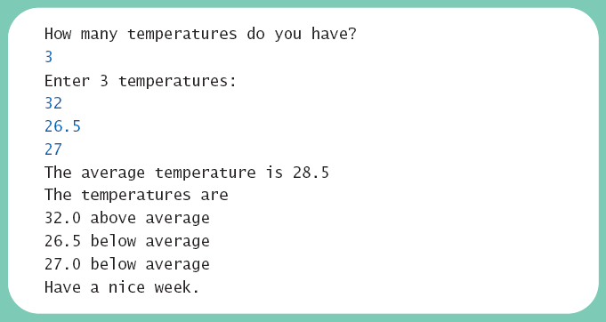
The Instance Variable length
Sample
screen output

Slide 13
More About Array Indices
Index of first array element is 0
Last valid Index is arrayName.length – 1
Array indices must be within bounds to be valid
  When program tries to access outside bounds, run time error occurs
OK to "waste" element 0
  Program easier to manage and understand
  Yet, get used to using index 0

Slide 14
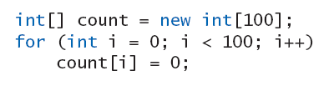
Initializing Arrays
Possible to initialize at declaration time
Also may use normal assignment statements
  One at a time
  In a loop

Slide 15
Arrays in Classes and Methods: Outline
Case Study: Sales Report
Indexed Variables as Method Arguments
Entire Arrays as Arguments to a Method
Arguments for the Method main
Array Assignment and Equality
Methods that Return Arrays

Slide 16
Case Study: Sales Report
Program to generate a sales report
Class will contain
  Name
  Sales figure
View class declaration, listing 7.3
class SalesAssociate

Slide 17
Case Study: Sales Report
Main subtasks for our program
Get ready
Obtain the data
Compute some statistics (update instance variables)
Display the results

Slide 18
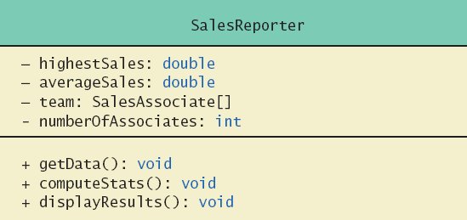
Case Study: Sales Report
Figure 7.3 Class diagram for class SalesReporter

Slide 19
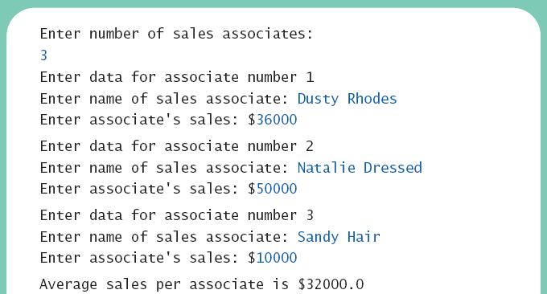
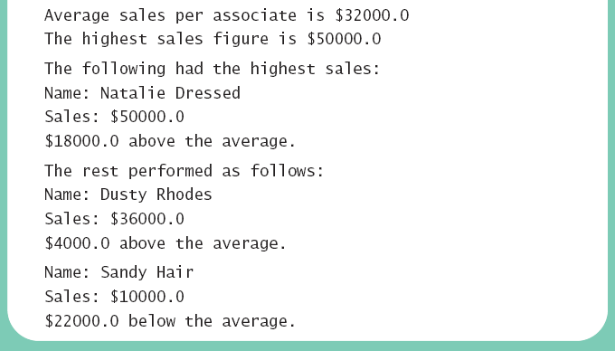
Case Study: Sales Report
View sales report program, listing 7.4
class SalesReporter
Sample
screen output

Slide 20
Indexed Variables as Method Arguments
Indexed variable of an array
  Example … a[i]
  Can be used anywhere variable of array base type can be used
View program using indexed variable as an argument, listing 7.5
class ArgumentDemo

Slide 21
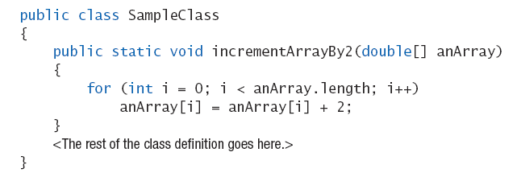
Entire Arrays as Arguments
Declaration of array parameter similar to how an array is declared
Example:

Slide 22
Entire Arrays as Arguments
Note – array parameter in a method heading does not specify the length
  An array of any length can be passed to the method
  Inside the method, elements of the array can be changed
When you pass the entire array, do not use square brackets in the actual parameter

Slide 23
Arguments for Method main
Recall heading of method main
public static void main (String[] args)
This declares an array
  Formal parameter named args
  Its base type is String
Thus possible to pass to the run of a program multiple strings
  These can then be used by the program

Slide 24
Array Assignment and Equality
Arrays are objects
  Assignment and equality operators behave (misbehave) as specified in previous chapter
Variable for the array object contains memory address of the object
  Assignment operator = copies this address
  Equality operator == tests whether two arrays are stored in same place in memory

Slide 25

Array Assignment and Equality
Two kinds of equality
View example program, listing 7.6
class TestEquals
Sample
screen output

Slide 26
Array Assignment and Equality
Note results of ==
Note definition and use of method equals
  Receives two array parameters
  Checks length and each individual pair of array elements
Remember array types are reference types

Slide 27
Gotcha – Don’t Exceed Array Bounds
The code below fails if the user enters a number like 4. Use input validation.
Scanner kbd = new Scanner(System.in);
int[] count = {0,0,0,0};
System.out.println("Enter ten numbers between 0 and 3.");
for (int i = 0; i < 10; i++)
{
int num = kbd.nextInt();
count[num]++;
}
for (int i = 0; i < count.length; i++)
System.out.println("You entered " + count[i] + " " + i + "'s");

Slide 28
Gotcha – Creating an Array of Objects
When you create an array of objects Java does not create instances of any of the objects! For example, consider the code:
We can’t access team[0] yet; it is null. First we must create references to an object:
we can now access team[0].getName() or team[1].getSalary()
SalesAssociate[] team = new SalesAssociate[10];
team[0] = new SalesAssociate("Jane Doe", 5000);
team[1] = new SalesAssociate("John Doe", 5000);

Slide 29
Methods that Return Arrays
A Java method may return an array
View example program, listing 7.7
class ReturnArrayDemo
Note definition of return type as an array
To return the array value
  Declare a local array
  Use that identifier in the return statement

Slide 30
Programming with Arrays and Classes: Outline
Programming Example: A Specialized List Class
Partially Filled Arrays

Slide 31
Programming Example
A specialized List class
  Objects can be used for keeping lists of items
Methods include
  Capability to add items to the list
  Also delete entire list, start with blank list
  But no method to modify or delete list item
Maximum number of items can be specified

Slide 32
Programming Example
View demo program, listing 7.8
class ListDemo
Note declaration of the list object
Note method calls

Slide 33
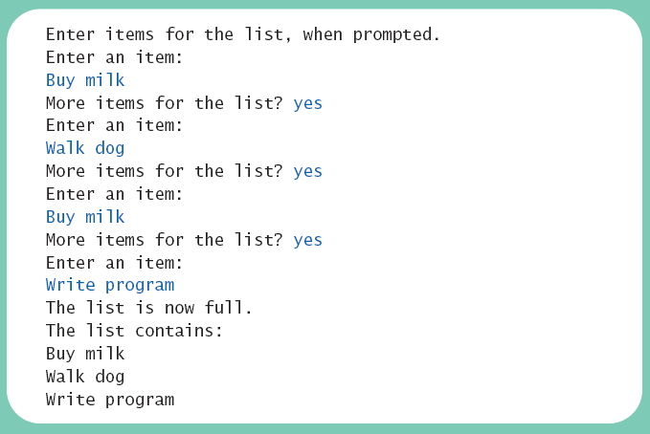
Programming Example
Sample
screen output

Slide 34
Programming Example
Now view array wrapped in a class to represent a list, listing 7.9
class OneWayNoRepeatsList
Notable code elements
  Declaration of private array
  Method to find n^{th} list item
  Method to check if item is on the list or not

Slide 35
Partially Filled Arrays
Array size specified at definition
Not all elements of the array might receive values
  This is termed a partially filled array
Programmer must keep track of how much of array is used

Slide 36
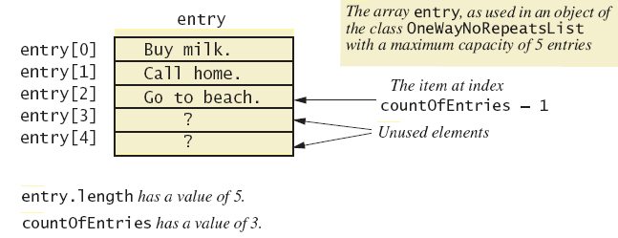
Partially Filled Arrays
Figure 7.4 A partially filled array

Slide 37
Sorting, Searching Arrays: Outline
Selection Sort
Other Sorting Algorithms
Searching an Array

Slide 38
Selection Sort
Consider arranging all elements of an array so they are ascending order
Algorithm is to step through the array
  Place smallest element in index 0
  Swap elements as needed to accomplish this
Called an interchange sorting algorithm

Slide 39
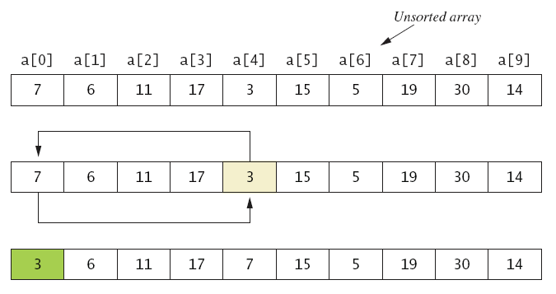
Selection Sort
Figure 7.5a

Slide 40
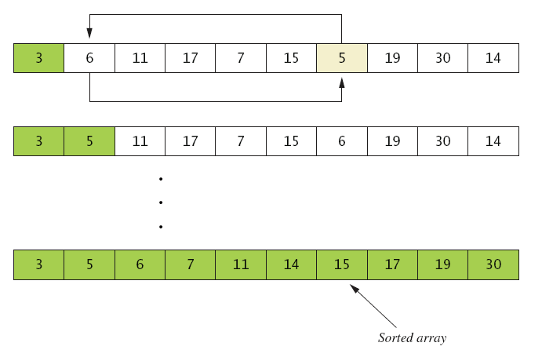
Selection Sort
Figure 7.5b
. . .

Slide 41
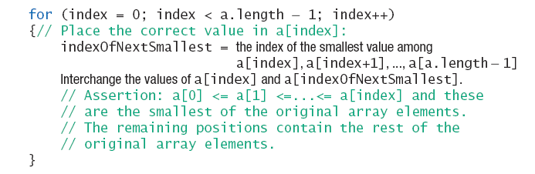
Selection Sort
Algorithm for selection sort of an array

Slide 42
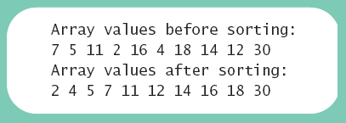
Selection Sort
View implementation of selection sort, listing 7.10
class ArraySorter
View demo program, listing 7.11
class SelectionSortDemo
Sample
screen output

Slide 43
Other Sorting Algorithms
Selection sort is simplest
  But it is very inefficient for large arrays
Java Class Library provides for efficient sorting
  Has a class called Arrays
  Class has multiple versions of a sort method

Slide 44
Searching an Array
Method used in OneWayNoRepeatsList is sequential search
  Looks in order from first to last
  Good for unsorted arrays
Search ends when
  Item is found … or …
  End of list is reached
If list is sorted, use more efficient searches

Slide 45
Multidimensional Arrays: Outline
Multidimensional-Array Basics
Multidimensional-Array Parameters and Returned Values
Java's Representation of Multidimensional
Ragged Arrays
Programming Example: Employee Time Records

Slide 46
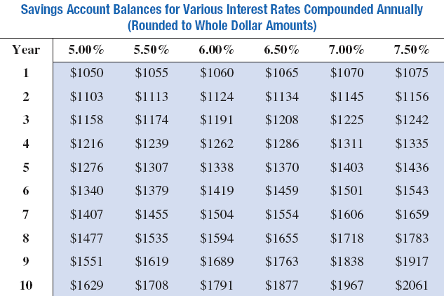
Multidimensional-Array Basics
Consider Figure 7.6, a table of values

Slide 47
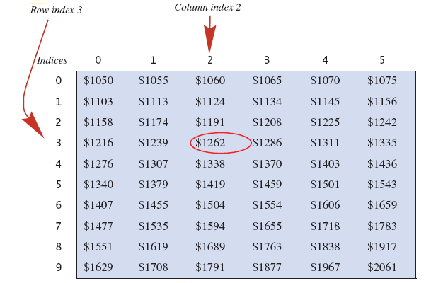
Multidimensional-Array Basics
Figure 7.7 Row and column indices for an array named table
table[3][2] has a value of 1262

Slide 48
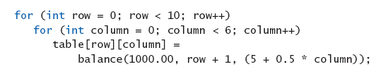
Multidimensional-Array Basics
We can access elements of the table with a nested for loop
Example:
View sample program, listing 7.12
class InterestTable

Slide 49
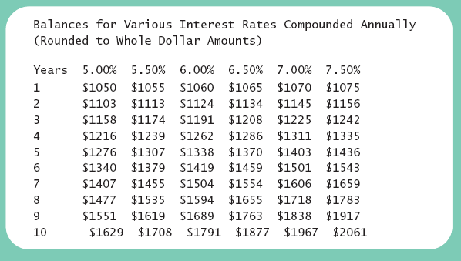
Multidimensional-Array Basics
Sample
screen output

Slide 50
Multidimensional-Array Parameters and Returned Values
Methods can have
  Parameters that are multidimensional-arrays
  Return values that are multidimensional-arrays
View sample code, listing 7.13
class InterestTable2

Slide 51
Java's Representation of Multidimensional Arrays
Multidimensional array represented as several one-dimensional arrays
Given
int [][] table = new int [10][6];
Array table is actually 1 dimensional of type int[]
  It is an array of arrays
Important when sequencing through multidimensional array

Slide 52
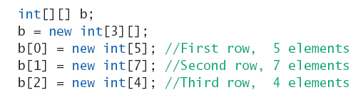
Ragged Arrays
Not necessary for all rows to be of the same length
Example:

Slide 53
Programming Example
Employee Time Records
  Two-dimensional array stores hours worked
    For each employee
    For each of 5 days of work week
  Array is private instance variable of class
View sample program, listing 7.14
class TimeBook

Slide 54
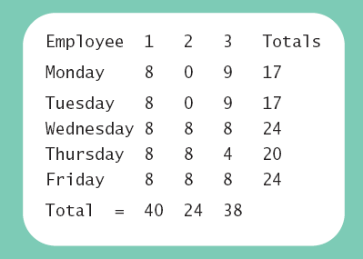
Programming Example
Sample
screen output

Slide 55
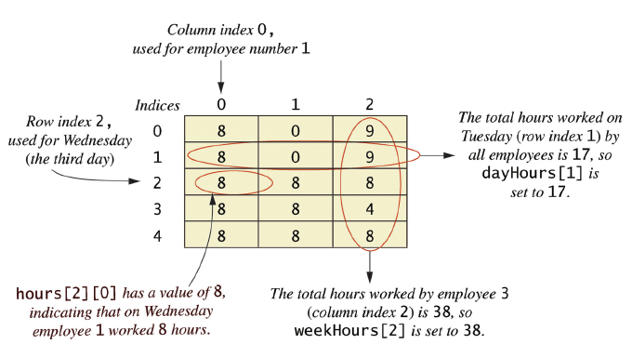
Programming Example
Figure 7.8 Arrays for the class TimeBook

Slide 56
Graphics Supplement: Outline
Text Areas and Text Fields
Programming Example: A Question-and-Answer Applet
The Classes JTextArea and JTextField
Drawing Polygons

Slide 57
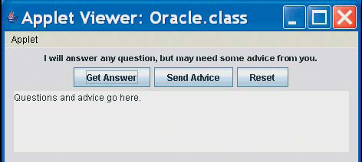
Text Areas, Text Fields
Text area is object of class JTextArea
  Displayed as a place for user to enter multiple lines of text
View sample code, listing 7.15
class Oracle
Sample
screen output

Slide 58
JTextArea and JTextField
Class JTextArea
  Used for multiple lines of user input
Class JtextField
  Used for single line of user input
Both classes include methods
  setText
  getText

Slide 59
Drawing Polygons
Class Graphics has method drawRect
  But only 4 sides and only 90 degree corners
Method drawPolygon can draw polygon of any number of sides
  Three arguments
    Array of int for x values of coordinates
    Array of int for y values of coordinates
    Number of points (vertices)
A polyline like a polygon, not closed

Slide 60
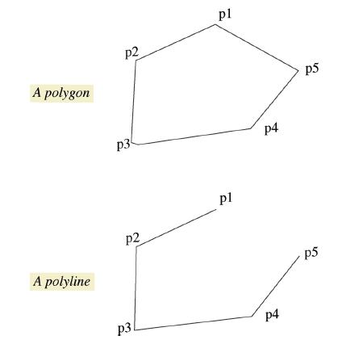
Drawing Polygons
Figure 7.9
A polygon and
a polyline

Slide 61
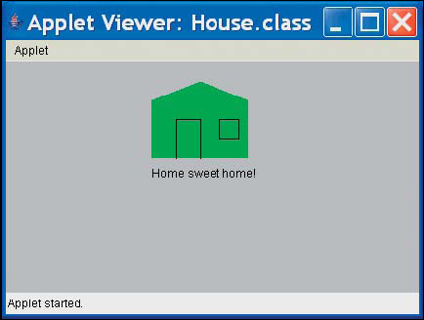
Drawing Polygons
View sample applet, listing 7.16
class House
House is a filled polygon
Door is a polyline
Window is an ordinary polygon
Sample
screen output

Slide 62
Summary
An array is a collection of variables all of the same type
Arrays are objects, created with operator new
Elements numbered starting with 0, ending with 1 less than length
Indexed variable can be used as a parameter – treated like variable of base type

Slide 63
Summary
Entire array can be passed as parameter to a method
Method return value can be an array
Partially filled array usually stores values in initial segment, use an int to track how many are used
Privacy leak caused by returning array corresponding to private instance variable

Slide 64
Summary
Selection sort orders an array into ascending or descending order
Multidimensional arrays are implemented as an array of arrays
Treat two-dimensional array as a table with rows and columns
Text fields, text areas in an applet provide areas for text input/output
Possible to draw polygons, polylines in an applet

